Slide 1
Follow the Steps to use API

Slide 2
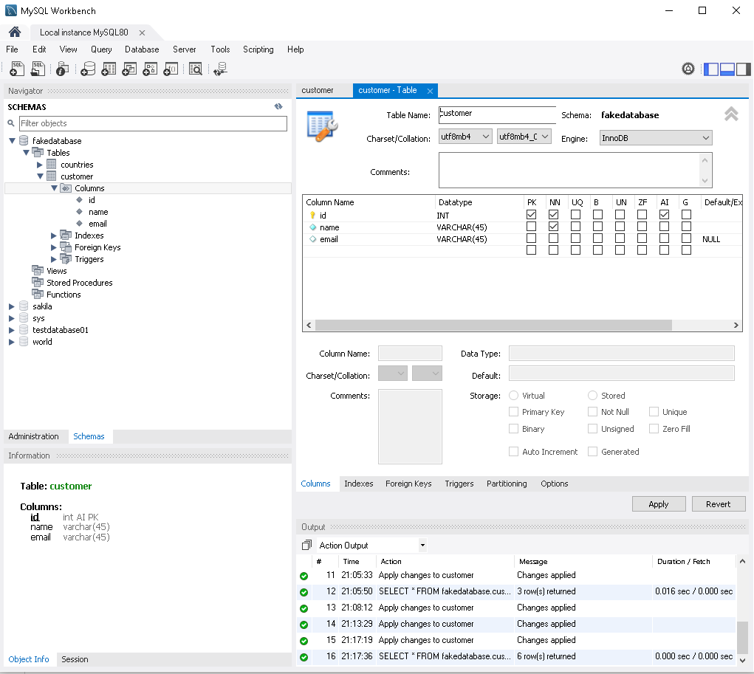
Set up mysql Database:
Open MySQL Workbench (install it on your local machine)
Create database with following specs or edit db.config.js file accordingly:
module.exports = {
HOST: "localhost",
USER: "root",
PASSWORD: "987654321",
DB: "fakedatabase"
};
Create table with name = customer
Create 3 columns in table as shown in screenshot – please take care of default parameters of columns created

Slide 3
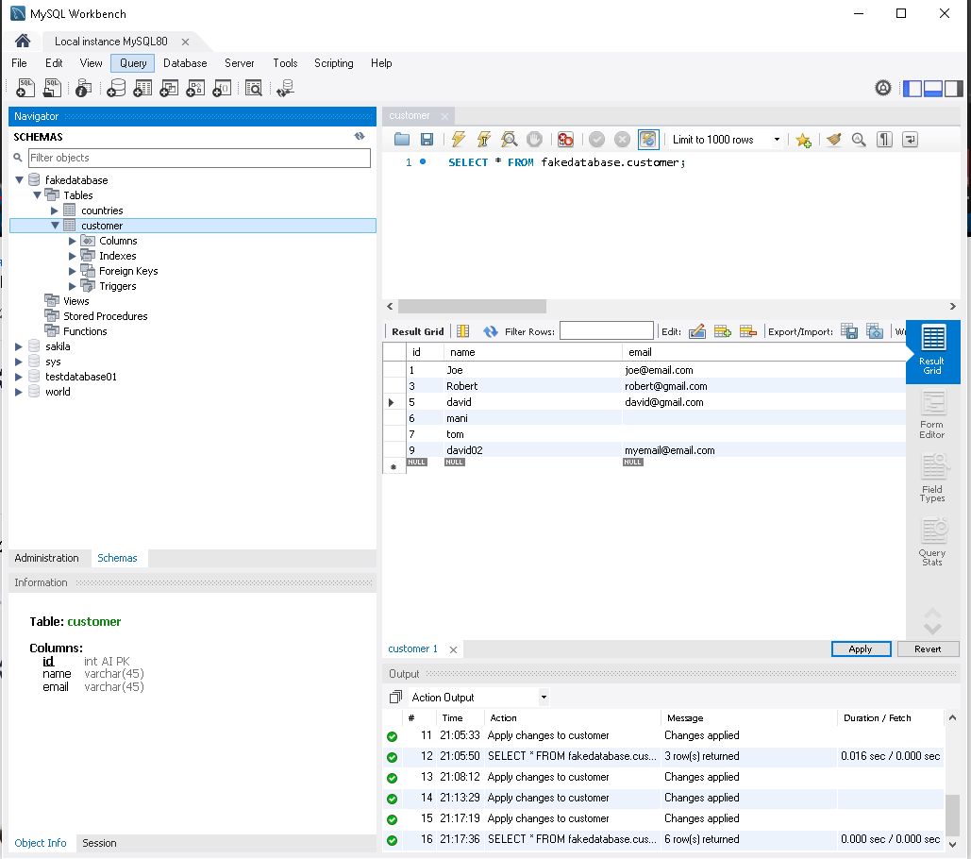
Set up mysql Database:
Final image of database

Slide 4
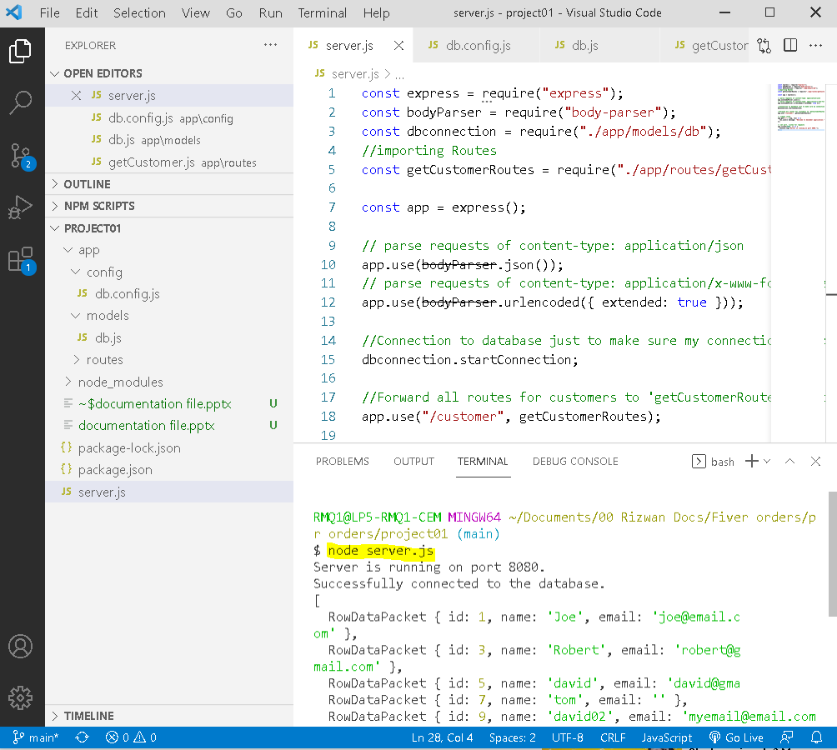
Run node server:
Open terminal
Run command:
node server.js
Or
nodemon server.js

Slide 5
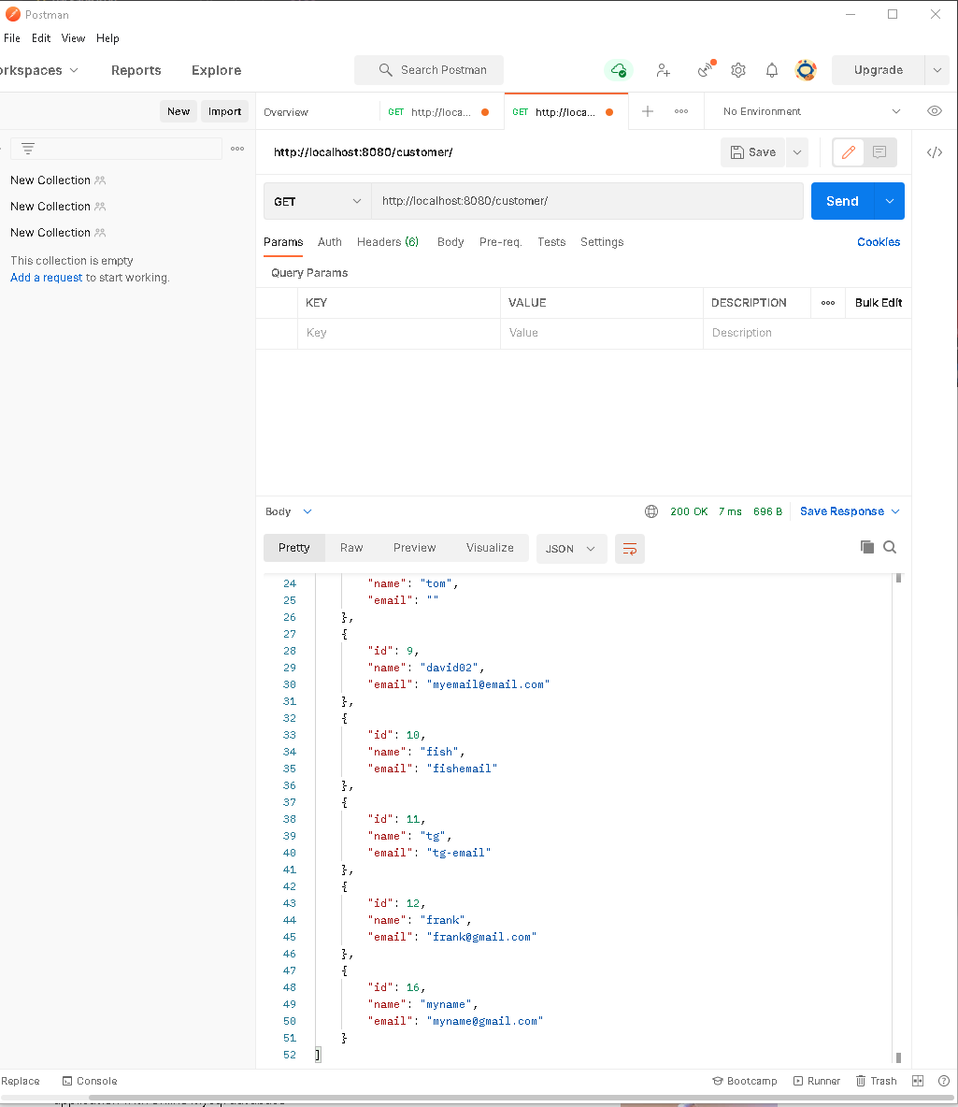
Setup Postman:
Install Postman on your local machine
Create collection and create basic HTTP request:
Commands:
GET:
http://localhost:8080/
http://localhost:8080/customer
http://localhost:8080/customer/5
POST
http://localhost:8080/customer/myname/myname@gmail.com
DELETE
http://localhost:8080/customer/14

